Slide 1
PRODUCT DEMAND PREDICTION

Slide 2

SVPM’s
COLLEGE OF ENGINEERING,
Malegaon (Bk)
DEPARTMENT OF COMPUTER ENGINEERING
Data Science
on
“Product Demand Prediction”
UNDER THE GUIDENCE OF
Prof. S. S. Nimbalkar

Slide 3
GROUP MEMBERS
Jamdade Vishwajit Sandip (Roll No.334)
Kunjir Shubham Ganesh (Roll No.357)
Salunkhe Hrutika Ravindra (Roll No.376)

Slide 4
TABLE OF CONTENTS
01
INTRODUCTION
02
03
05
ALGORITHM
PROBLEM STATEMENT
06
RESULT
OBJECTIVES
07
CONCLUSION
04
SYSTEM ARCHITECTURE
08
REFERENCES

Slide 5
INTRODUCTION
A product company plans to offer discounts on its product during the upcoming holiday season. The company wants to find the price at which its product can be a better deal compared to its competitors. For this task, the company provided a dataset of past changes in sales based on price changes. You need to train a model that can predict the demand for the product in the market with different price segments.

Slide 6
PROBLEM STATEMENT
To train a model that can predict demand of the product in the market with different price segments from the given dataset.

Slide 7
OBJECTIVES
The Objectives of Product Demand Prediction are:
Financial planning,
Pricing policy
Manufacturing policy
Sales, and Marketing planning
Capacity planning and expansion

Slide 8
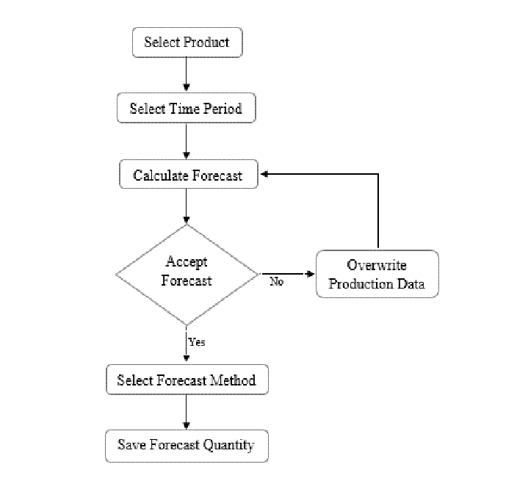
SYSTEM ARCHITECTURE

Slide 9
ALGORITHM
Step 6: Deliver the outputs that users need quickly
Step 7: Combine different techniques
Step 8: Reality check the forecast
Step 9: Reforecast, reforecast and reforecast some more
Step 10: Be prepared to cut your losses
Step 1: Make it a collaborative effort
Step 2: Identify and agree upon the assumptions
Step 3: Build granular models
Step 4: Use flexible time periods
Step 5: Generate a range of forecasts

Slide 10
RESULTS

Slide 11

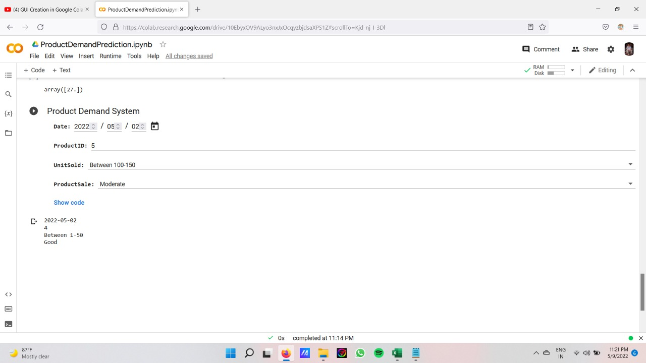

Slide 12
CONCLUSION
Created a Web Application which will Create, Add, Update, Delete and Shows all the question data on the webpage by using Angular (Material) and JSON Server (Database).
Where we can store the data about the questions like Que Id, Name, Option A, B, C, D, E, Answer, Level, Time, Type, Section and Subject etc.

Slide 13
REFERENCES
[1] Huang Zongxiang, Research on the Prediction of Product Demand under Market Economy, 2011.
[2] Pan Ershun, Production Plan and Control [M]. Shanghai: Shanghai iao Tong University Press, 2003:pp.25-27.
[3] Wang Lili, Zhang Fengrong, Production Plan and Control [M]. Beijing: Mechanical Industry Press, 2006:pp.19-25.
[4] Bao Fengxian, Chen Hongli, Prediction and Decision-making Methodof Economy [M]. Guangzhou: Jinan University Press, 2007.8:pp.8-12.

Slide 14

THANK YOU

